Slide 1

Broken to be Blessed
Rev. Simon Tan
    Copy right belongs to Rever Ministries. Permission is required for the use of the content.

Slide 2

Genesis 創世紀
32:1-31
“Lord bless me!” The prayer of every Christian

Slide 3

1. God doesn’t use shortcuts to bless
Genesis 32:1-6
Jacob also went on his way, and the angels of God met him. When Jacob saw them, he said, “This is the camp of God!” So he named that place Mahanaim. Jacob sent messengers ahead of him to his brother Esau in the land of Seir, the country of Edom. He instructed them: “This is what you are to say to my lord Esau: ‘Your servant Jacob says, I have been staying with Laban and have remained there till now. I have cattle and donkeys, sheep and goats, male and female servants. Now I am sending this message to my lord, that I may find favor in your eyes.’” When the messengers returned to Jacob, they said, “We went to your brother Esau, and now he is coming to meet you, and four hundred men are with him.”
創世紀32:1-6
雅各 繼續行路， 神的使者遇見他。 雅各 看見他們就說：「這是 神的軍營。」於是給那地方起名叫 瑪哈念 。 雅各 派使者在他前面到 西珥 地，就是 以東 地他哥哥 以掃 那裏。 他吩咐他們說：「你們要對我主 以掃 說：『你的僕人 雅各 這樣說：我在 拉班 那裏寄居，延遲到如今。 我有牛、驢、羊羣、奴僕、婢女，現在派人來報告我主，為了要在你眼前蒙恩。』」 使者回到 雅各 那裏，說：「我們到了你哥哥 以掃 那裏。他正迎着你來，並且有四百人和他一起。」

Slide 4
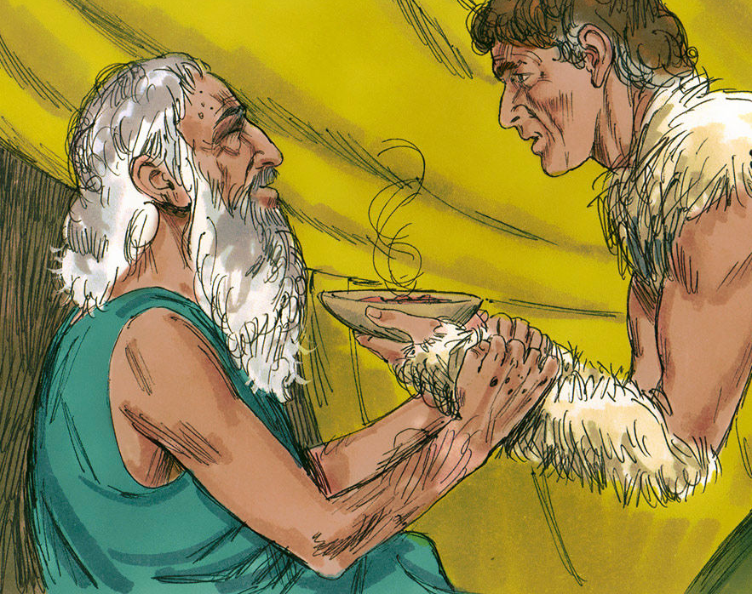
Jacob
Meaning: “He deceives”
Jacob’s favourite shortcut to gain blessings
God chose to break Jacob before He could bless him
Notes:
https://youtu.be/J-p4N_5I4YY

Slide 5
2. God breaks us to make us whole
Genesis 32:7-12
In great fear and distress Jacob divided the people who were with him into two groups, and the flocks and herds and camels as well. He thought, “If Esau comes and attacks one group, the group that is left may escape. ”Then Jacob prayed, “O God of my father Abraham, God of my father Isaac, Lord, you who said to me, ‘Go back to your country and your relatives, and I will make you prosper,’ I am unworthy of all the kindness and faithfulness you have shown your servant. I had only my staff when I crossed this Jordan, but now I have become two camps. Save me, I pray, from the hand of my brother Esau, for I am afraid he will come and attack me, and also the mothers with their children. But you have said, ‘I will surely make you prosper and will make your descendants like the sand of the sea, which cannot be counted.’”
創世紀32:7-12
雅各 就很懼怕，而且愁煩。他把跟他同行的人和羊羣、牛羣、駱駝分成兩隊， 說：「 以掃 若來擊殺其中一隊，剩下的另一隊還可以逃脫。」 雅各 說：「耶和華—我祖父 亞伯拉罕 的 神，我父親 以撒 的 神啊，你曾對我說：『回你本地本族去，我要厚待你。』 你向僕人所施的一切慈愛和信實，我一點也不配得。我先前只用我的一根杖過這 約旦河 ，如今我卻成了兩隊。 求你救我脫離我哥哥的手，脫離 以掃 的手，因為我怕他來殺我，連母親和兒女都不放過。 你曾說：『我必定厚待你，使你的後裔如同海邊的沙，多得不可勝數。』」

Slide 6
God cannot be mocked
Continue
To Worship God

Slide 7

Submit yourself to God’s authority
God uses your loved one to break you.
Don’t loose your heart.

Slide 8
3. When you are broken, seek God
Genesis 32:12-21
But you have said, ‘I will surely make you prosper and will make your descendants like the sand of the sea, which cannot be counted.’” He spent the night there, and from what he had with him he selected a gift for his brother Esau: ¹⁴ two hundred female goats and twenty male goats, two hundred ewes and twenty rams, thirty female camels with their young, forty cows and ten bulls, and twenty female donkeys and ten male donkeys. He put them in the care of his servants, each herd by itself, and said to his servants, “Go ahead of me, and keep some space between the herds.” He instructed the one in the lead: “When my brother Esau meets you and asks, ‘Who do you belong to, and where are you going, and who owns all these animals in front of you?’ then you are to say, ‘They belong to your servant Jacob. They are a gift sent to my lord Esau, and he is coming behind us.’” He also instructed the second, the third and all the others who followed the herds: “You are to say the same thing to Esau when you meet him. And be sure to say, ‘Your servant Jacob is coming behind us.’” For he thought, “I will pacify him with these gifts I am sending on ahead; later, when I see him, perhaps he will receive me.” So Jacob’s gifts went on ahead of him, but he himself spent the night in the camp.
創世紀32:12-21
你曾說：『我必定厚待你，使你的後裔如同海邊的沙，多得不可勝數。』」 當夜， 雅各 在那裏住宿，就從他手中所擁有的拿禮物要送給他哥哥 以掃 ， 就是二百隻母山羊、二十隻公山羊、二百隻母綿羊、二十隻公綿羊、 三十匹哺乳的母駱駝和牠們的小駱駝、四十頭母牛、十頭公牛、二十匹母驢和十匹公驢。 他把每種牲畜各分一羣，交在僕人手中，對僕人說：「你們要在我的前頭過去，使羣和羣之間保持一段距離」。 他又吩咐領頭的人說：「我哥哥 以掃 遇見你的時候，問你說：『你是誰的人？要往哪裏去？你前面這些是誰的？』 你就說：『是你僕人 雅各 的，是送給我主 以掃 的禮物。看哪，他自己也在我們後面。』」 他又吩咐第二、第三和所有趕畜羣的人說：「你們遇見 以掃 的時候要照這樣的話對他說， 你們還要說：『看哪，你僕人 雅各 在我們後面。』」因 雅各 說：「我藉着在我前面送去的禮物給他面子，然後再見他的面，或許他會寬容我。」 於是禮物在他前面過去了；那夜， 雅各 在營中住宿。

Slide 9
3. When you are broken, seek God
Genesis 32:22-31
That night Jacob got up and took his two wives, his two female servants and his eleven sons and crossed the ford of the Jabbok. After he had sent them across the stream, he sent over all his possessions. So Jacob was left alone, and a man wrestled with him till daybreak. When the man saw that he could not overpower him, he touched the socket of Jacob’s hip so that his hip was wrenched as he wrestled with the man. Then the man said, “Let me go, for it is daybreak.” But Jacob replied, “I will not let you go unless you bless me.” The man asked him, “What is your name?” “Jacob,” he answered. Then the man said, “Your name will no longer be Jacob, but Israel, because you have struggled with God and with humans and have overcome.” Jacob said, “Please tell me your name.”
But he replied, “Why do you ask my name?” Then he blessed him there. So Jacob called the place Peniel, saying, “It is because I saw God face to face, and yet my life was spared.” The sun rose above him as he passed Peniel, and he was limping because of his hip.
創世紀32:22-31
他夜間起來，帶着兩個妻子，兩個婢女和十一個孩子，過了 雅博 渡口。 他帶着他們，送他們過河，他所有的一切也都過去， 只剩下 雅各 一人。有一個人來和他摔跤，直到黎明。 那人見自己勝不過他，就摸了他的大腿窩一下。 雅各 的大腿窩就在和那人摔跤的時候扭了。 那人說：「天快亮了，讓我走吧！」 雅各 說：「你不給我祝福，我就不讓你走。」 那人說：「你叫甚麼名字？」他說：「 雅各 。」 那人說：「你的名字不要再叫 雅各 ，要叫 以色列 ，因為你與 神和人較力，都得勝了。」 雅各 問他說：「請告訴我你的名字。」那人說：「何必問我的名字呢？」於是他在那裏為 雅各 祝福。
雅各 就給那地方起名叫 毗努伊勒 ，說：「我面對面見了 神，我的性命仍得保全。」 太陽剛出來的時候， 雅各 經過 毗努伊勒 ，他的大腿就瘸了。

Slide 10
Grab God, and seek spiritual blessings from Him.
When you seek spiritual blessings, material blessings will follow.

Slide 11
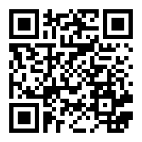
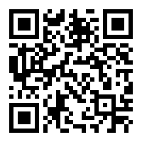
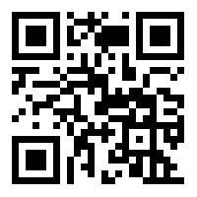
Facebook
Instagram
Website
Email: Reverministries@gmail.com
Thank You

